Slide 1
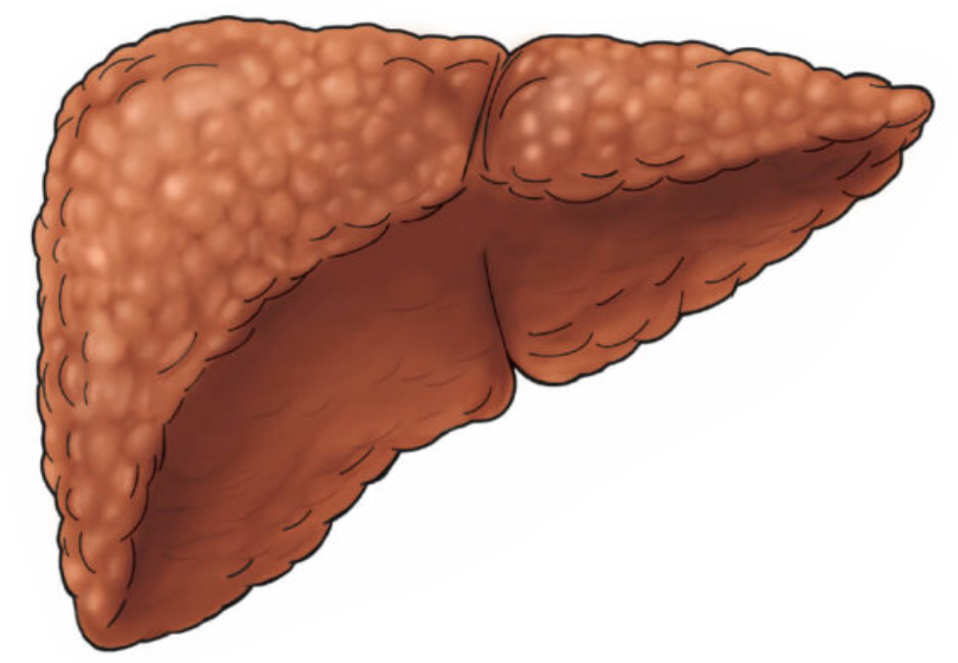

Cirrhosis
A beginners guide
Mohammad Almeqdadi, MD
Transplant Hepatologist and Gastroenterologist
Assistant Professor of Medicine and Surgery

Slide 2
Outline
Definition
Pathophysiology
Diagnosis
Etiology
Prognosis
Case

Slide 3
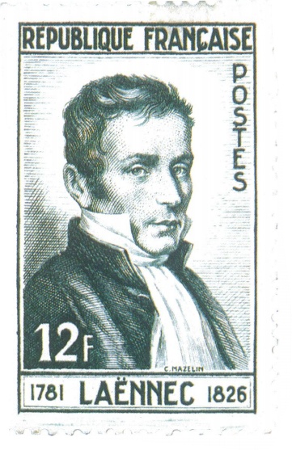

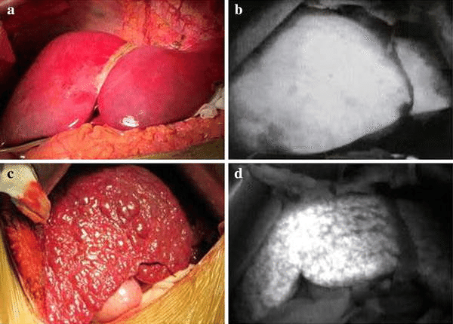
Definition

Slide 4
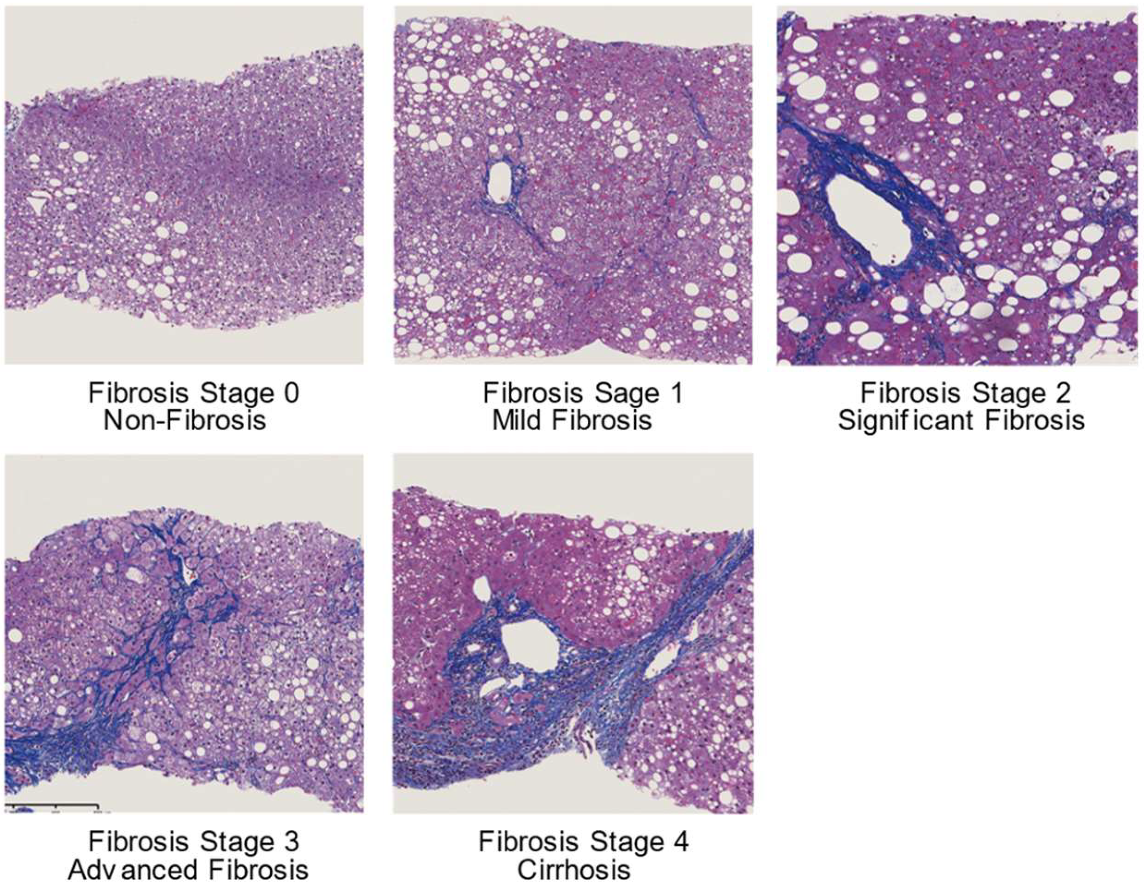
Histologically

Slide 5
Pathophysiology
Disruption of hepatic function
  What is the hepatocyte function?
Disruption of portal blood flow
  What is a portal vein?
  Do you know of other portal veins in the body?

Slide 6
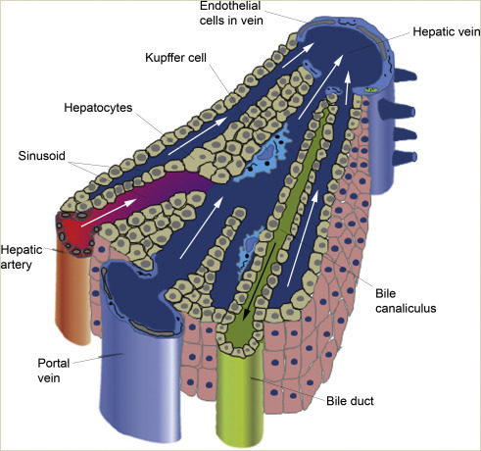
Hepatocyte function
Most bodily metabolism and detoxification of blood happens in the liver
Important functions include
  Conjugation of bilirubin
  Excretion of bilirubin in bile
  Production of coagulation factors
  Urea cycle

Slide 7
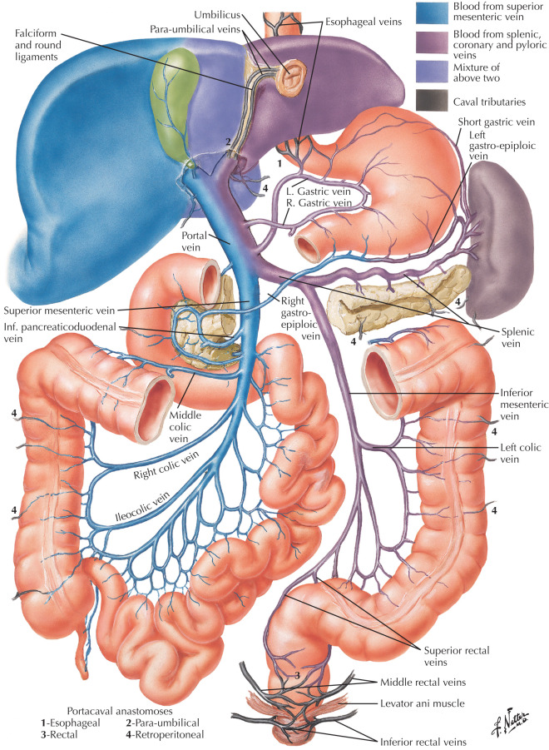
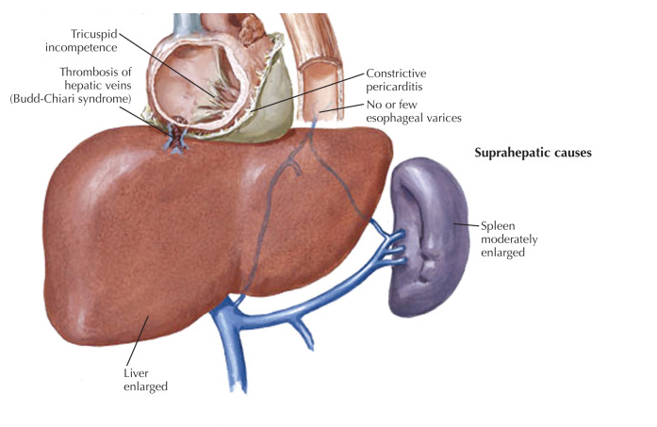
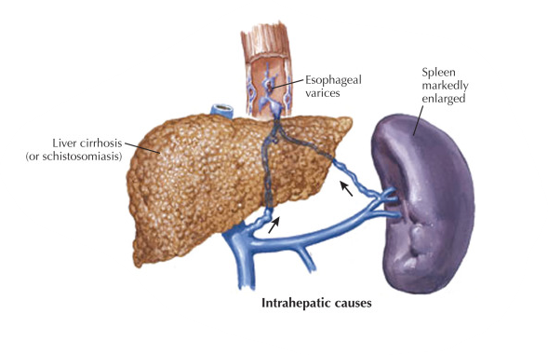
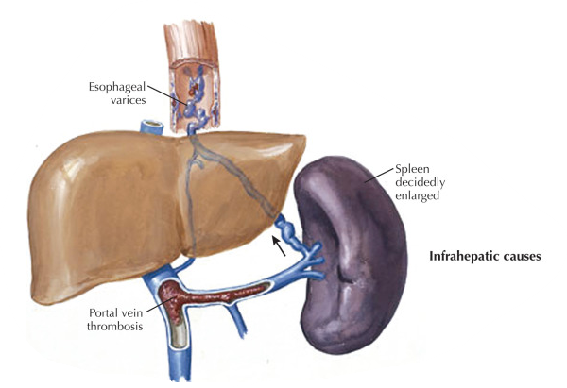
Portal venous system

Slide 8
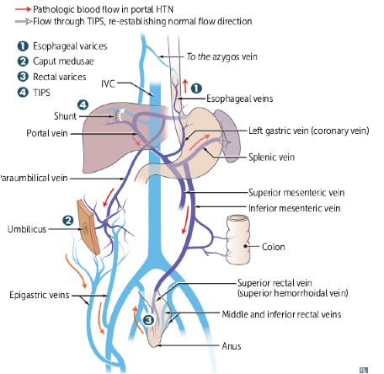
Portal hypertension
Multiple portosystemic anastomotic sites exist
When the portal pressure is high, these sites will be engorged with blood as shunted paths to the systemic circulation

Slide 9
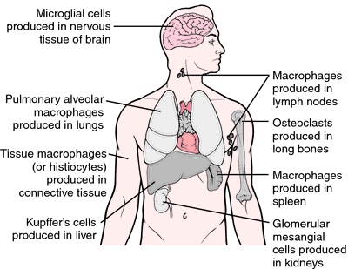
Reticuloendothelial system
The RES is the system of monocyte-macrophage axes that engulf pathogens
Main organs are the bone marrow -> spleen -> liver
In adults, 90% of RES is processed in the liver

Slide 10
Splenomegaly
Why does the spleen increase in size in cirrhosis?

Slide 11
Splenomegaly
Why does the spleen increase in size in cirrhosis?
Compensatory mechanism for RES function
Portal hypertension causes splenic venous congestion

Slide 12
Splenomegaly
Why does the spleen increase in size in cirrhosis?
Compensatory mechanism for RES function
Portal hypertension causes splenic venous congestion
If you were to give a tagged colloid that the macrophages uptake to process, and capture a nuclear image of the body, what will you see?

Slide 13
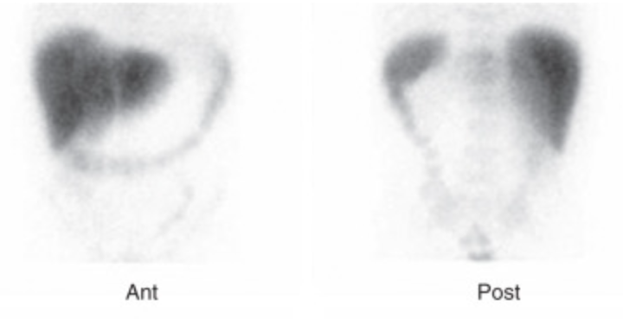
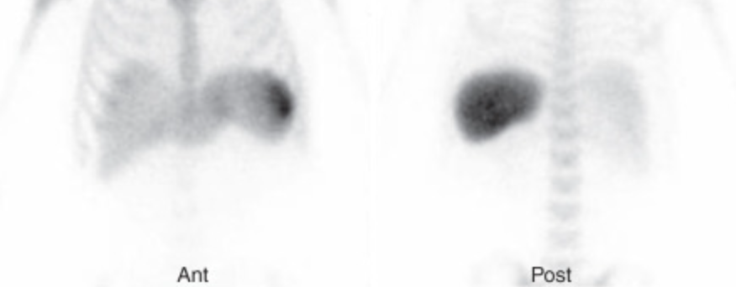
Liver Spleen Scan
A
B

Slide 14
Liver Spleen Scan
Normal scan
Cirrhosis

Slide 15
Thrombocytopenia
Thrombocytopenia results due to three reasons
Sequestration in the, now enlarged, spleen
Myelosuppression (bone marrow also takes role for RES)
Low levels of thrombopoietin (TPO) produced in the liver

Slide 16
Thrombocytopenia
Thrombocytopenia results due to three reasons
Sequestration in the, now enlarged, spleen
Myelosuppression (bone marrow also takes role for RES)
Low levels of thrombopoietin (TPO) produced in the liver
Thrombocytopenia is a sign of chronic liver disease or cirrhosis until proven otherwise!

Slide 17
Diagnosis
Varying accuracy compared to the Gold Standard.
Labs (AST, PLT, Tbili, Alb, INR)
Scoring systems (FIB4, APRI, Fibrosure, ELF, etc.)
Noninvasive Elastography (Fibroscan, USE, MRE, etc.)
Imaging (US, CT, MRI, LS scan)
Biopsy (Gold standard)

Slide 18
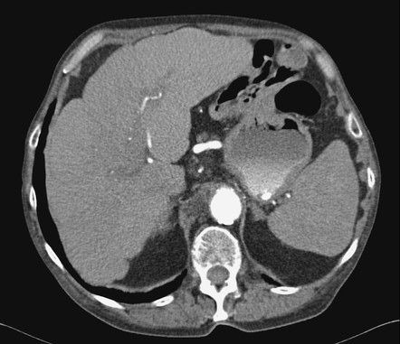
CT Imaging
Nodular contour (can be very subtle)
Caudate lobe hypertrophy
Sequalae of portal hypertension
  Recanalization of the umbilical vein
  Varices
Splenomegaly

Slide 19
So what causes cirrhosis?

Slide 20
What causes cirrhosis?
Hepatotoxicity
  Alcohol
  Medications
  Other hepatotoxins (e.g. aflatoxin)
Inflammation
  Viral hepatitis
  Autoimmune hepatitis
  PBC
  PSC
  Parasitic infections
Metabolic disease
  MASLD (formerly NAFLD)
  Hemochromatosis
  Wilson disease
  Alpha-1 antitrypsin deficiency
Vascular causes
  Budd-Chiari syndrome
  Cardiac cirrhosis (nutmeg)
Cryptogenic

Slide 21
How to investigate the etiology of cirrhosis?
Hepatotoxicity
  History and physical exam
Inflammation
  HBV and HCV serologies
  ANA, ASMA, AMA
Metabolic disease
  Iron panel and ferritin
  Ceruloplasmin (if age < 40)
  A1AT level + Phenotype
Vascular causes
  U/S with dopplers
Cryptogenic

Slide 22
Management

Slide 23
Management
Prognostication
Compensated vs Decompensated
Is cirrhosis reversible? No -> once cirrhotic, always cirrhotic
Manage the complications of cirrhosis
Transplant evaluation

Slide 24
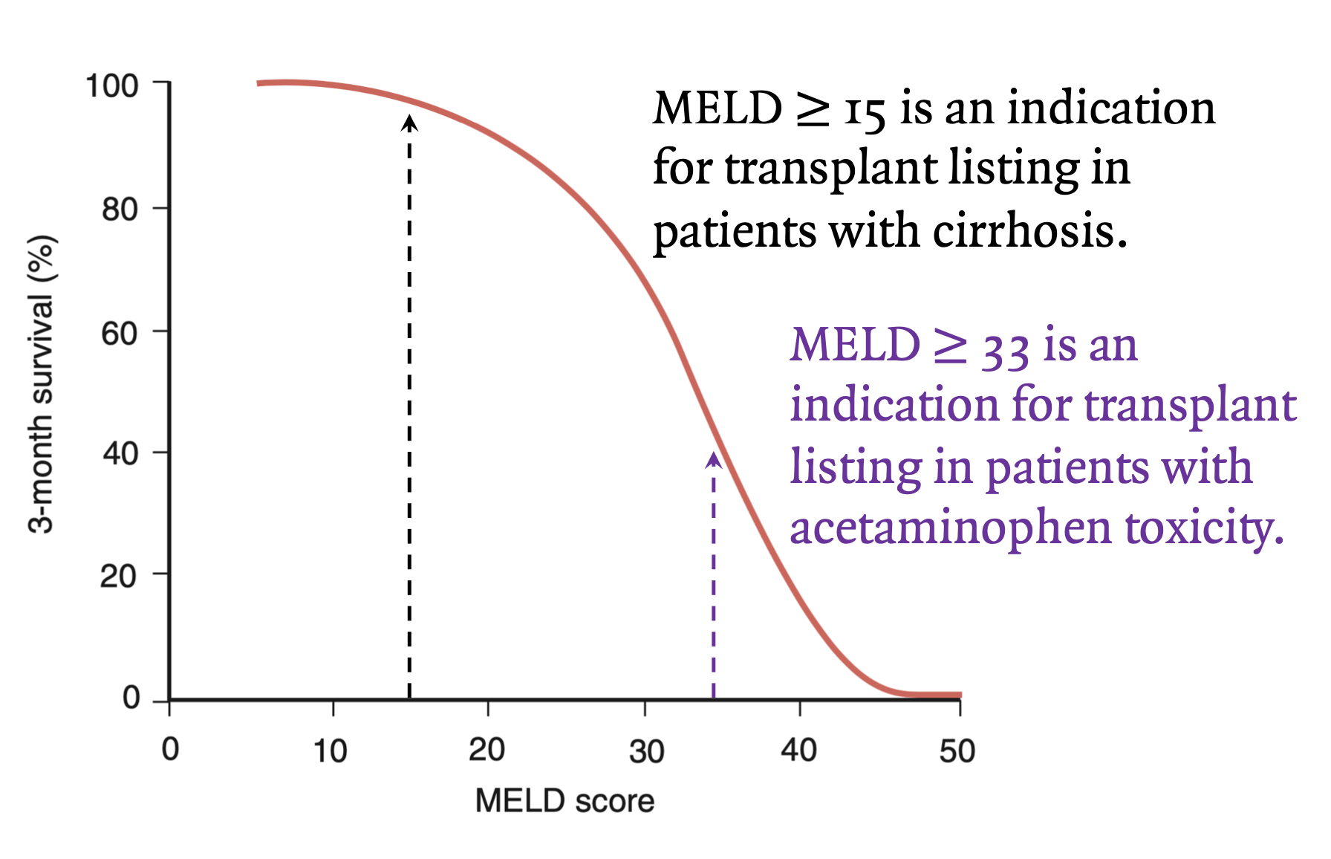
MELD and Child-Pugh Score
MELD |  | Total bilirubin |  |  |  |  | Points | 1 | 2 | 3
 | sCr | 1 | 2 | 3 | 4 |  | Tbili | < 2 | 2-3 | >3
INR = 1 | 1 | 6 | 9 | 11 | 12 |  | Alb | > 3.5 | 2.8–3.5 | < 2.8
 | 1.5 | 10 | 13 | 14 | 16 |  | INR | < 1.7 | 1.7–2.3 | > 2.3
 | 2 | 13 | 16 | 17 | 18 |  | Ascites | None | Mild | Mod+
 | 3 | 17 | 20 | 21 | 22 |  | Enceph | None | I-II | III-IV
 | 4 | 20 | 22 | 24 | 25 |  | Total | 5-6 | 7-9 | 10-15
INR = 1.5 | 1 | 11 | 14 | 15 | 16 |  | CTP | A | B | C
 | 1.5 | 15 | 17 | 19 | 20
 | 2 | 18 | 20 | 22 | 23
 | 3 | 21 | 24 | 26 | 27
 | 4 | 24 | 27 | 28 | 29
INR = 2 | 1 | 14 | 17 | 18 | 19
 | 1.5 | 18 | 21 | 22 | 23
 | 2 | 21 | 23 | 25 | 26
 | 3 | 25 | 27 | 29 | 30
 | 4 | 27 | 30 | 32 | 33
INR = 3 | 1 | 19 | 21 | 23 | 24
 | 1.5 | 23 | 25 | 27 | 28
 | 2 | 25 | 28 | 30 | 31
 | 3 | 29 | 32 | 33 | 34
 | 4 | 32 | 35 | 36 | 37

Slide 25
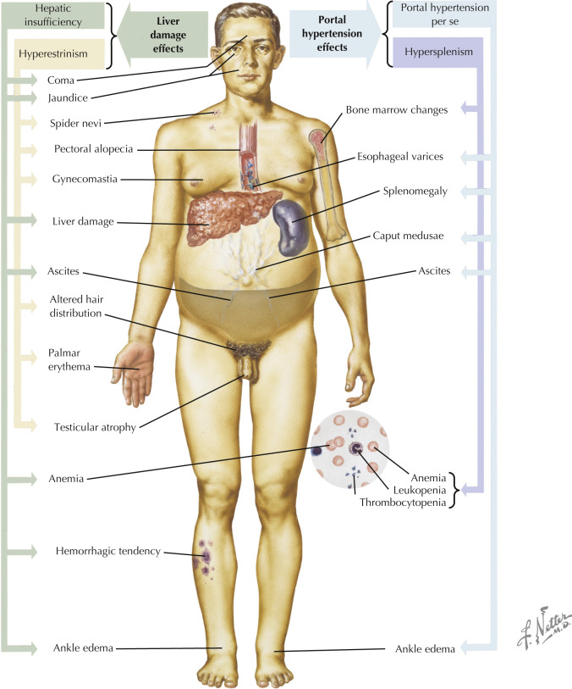
Decompensated cirrhosis
Jaundice
Hepatic encephalopathy
GI bleed
Ascites
Hepatocellular carcinoma
…

Slide 26
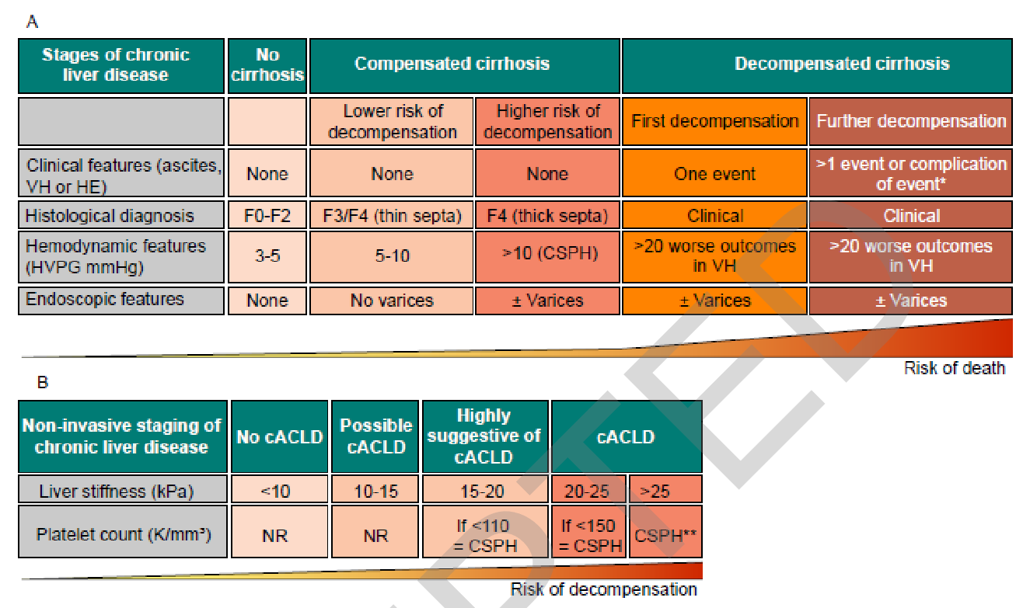
Kaplan DE, Bosch J, Ripoll C, Thiele M, Fortune BE, Simonetto DA, Garcia-Tsao G.
AASLD practice guidance on risk stratification and management of portal hypertension and varices in cirrhosis. Hepatology. 2023 Oct 23

Slide 27
Management of Cirrhosis
No cure for cirrhosis apart from liver transplant
Cirrhotics mortality stems from infections and HCC
Focus is to prevent complications of cirrhosis and portal hypertension
What is the most important factor in cirrhotics management?

Slide 28
Management of Cirrhosis
No cure for cirrhosis apart from liver transplant
Cirrhotics mortality stems from infections and HCC
Focus is to prevent complications of cirrhosis and portal hypertension
What is the most important factor in cirrhotics management?
Prevent further damage by stopping the offending agent (Alcohol) or treating the underlying cause (AIH, NASH, etc.)

Slide 29
Management of complications of cirrhosis
Portal hypertension
  Gastroesophageal varices
  Portal hypertensive gastropathy
  Hypersplenism
  Ascites -> SBP
  Hepatorenal syndrome
  ?Hepatopulmonary syndrome
  Portopulmonary syndrome
Immune dysfunction
Coagulopathy
  Increased risk of bleeding
  Portal venous thrombosis
Hepatic encephalopathy
Hepatocellular carcinoma

Slide 30
Case Presentation

Slide 31
Case
Patient is a 54-year-old man with history of alcohol use disorder who is being seen by you in the office to review his labs.

Slide 32
Case
Patient is a 54-year-old man with history of alcohol use disorder who is being seen by you in the office to review his labs.
AST | 50
ALT | 20
ALP | 40
GGT | 300
Tbili | 1.5
INR | 1.2
Albumin | 3.0
Platelets | 150
MCV | 95

Slide 33
Case
Patient is a 54-year-old man with history of alcohol use disorder who is being seen by you in the office to review his labs.
What’s the next step in management?
AST | 50
ALT | 20
ALP | 40
GGT | 300
Tbili | 1.5
INR | 1.2
Albumin | 3.0
Platelets | 150
MCV | 95

Slide 34
Case
Patient is a 54-year-old man with history of alcohol use disorder who is being seen by you in the office to review his labs.
What’s the next step in management?
Alcohol cessation
Chronic liver disease work up
  HBV, HCV serologies
  ANA, ASMA, AMA, SPEP
  Iron panel and ferritin
  Ceruloplasmin, A1AT phenotype + levels
AST | 50
ALT | 20
ALP | 40
GGT | 300
Tbili | 1.5
INR | 1.2
Albumin | 3.0
Platelets | 150
MCV | 95

Slide 35
54-year-old man with alcohol use disorder
HBV | Negative
HCV | Negative
ANA | Negative
ASMA | Negative
AMA | Negative
Ceruloplasmin | Normal
A1AT | Normal
TIBC | 300
Iron | 100
Ferritin | 4000

Slide 36
54-year-old man with alcohol use disorder
Does this patient have hemochromatosis?
HBV | Negative
HCV | Negative
ANA | Negative
ASMA | Negative
AMA | Negative
Ceruloplasmin | Normal
A1AT | Normal
TIBC | 300
Iron | 100
Ferritin | 4000

Slide 37
54-year-old man with alcohol use disorder
Does this patient have hemochromatosis?
  No, transferrin sat is 33% (require > 45-55%)
What is the etiology of his cirrhosis?
HBV | Negative
HCV | Negative
ANA | Negative
ASMA | Negative
AMA | Negative
Ceruloplasmin | Normal
A1AT | Normal
TIBC | 300
Iron | 100
Ferritin | 4000

Slide 38
54-year-old man with alcohol use disorder
Does this patient have hemochromatosis?
  No, transferrin sat is 33% (require > 45-55%)
What is the etiology of his cirrhosis?
  Alcohol
What’s your next step?
  We never proved that he even has cirrhosis!
HBV | Negative
HCV | Negative
ANA | Negative
ASMA | Negative
AMA | Negative
Ceruloplasmin | Normal
A1AT | Normal
TIBC | 300
Iron | 100
Ferritin | 4000

Slide 39
54-year-old man with alcohol use disorder
Checking for cirrhosis:
Calculations: Fib-4 = 4.02
  Fib-4>3.25 = 97% specificity and 65% PPV for cirrhosis

Slide 40
54-year-old man with alcohol use disorder
Checking for cirrhosis:
Calculations: Fib-4 = 4.02
  Fib-4>3.25 = 97% specificity and 65% PPV for cirrhosis
RUQ U/S: no cirrhosis

Slide 41
54-year-old man with alcohol use disorder
Checking for cirrhosis:
Calculations: Fib-4 = 4.02
  Fib-4>3.25 = 97% specificity and 65% PPV for cirrhosis
RUQ U/S: no cirrhosis
CT A/P: no cirrhosis, no pHTN

Slide 42
54-year-old man with alcohol use disorder
Checking for cirrhosis:
Calculations: Fib-4 = 4.02
  Fib-4>3.25 = 97% specificity and 65% PPV for cirrhosis
RUQ U/S: no cirrhosis
CT A/P: no cirrhosis, no pHTN
Elastography: F2-3 (cirrhosis is F4)

Slide 43
54-year-old man with alcohol use disorder
Checking for cirrhosis:
Calculations: Fib-4 = 4.02
  Fib-4>3.25 = 97% specificity and 65% PPV for cirrhosis
RUQ U/S: no cirrhosis
CT A/P: no cirrhosis, no pHTN
Elastography: F2-3 (cirrhosis is F4)
Do you dig more or do you stop?

Slide 44
54-year-old man with alcohol use disorder
Checking for cirrhosis:
Calculations: Fib-4 = 4.02
  Fib-4>3.25 = 97% specificity and 65% PPV for cirrhosis
RUQ U/S: no cirrhosis
CT A/P: no cirrhosis, no pHTN
Elastography: F2-3 (cirrhosis is F4)
Liver spleen scan: findings suggestive of cirrhosis

Slide 45
54-year-old man with alcohol use disorder
Checking for cirrhosis:
Calculations: Fib-4 = 4.02
  Fib-4>3.25 = 97% specificity and 65% PPV for cirrhosis
RUQ U/S: no cirrhosis
CT A/P: no cirrhosis, no pHTN
Elastography: F2-3 (cirrhosis is F4)
Liver spleen scan: findings suggestive of cirrhosis
Liver biopsy: F4 bridging fibrosis and cirrhosis
  Iron stain negative (Prussian blue)
  Copper stain negative (Rhodamine)
  A1AT stain negative (PAS diastase resistant)
  Mallory bodies and macrovesicular steatosis

Slide 46
54-year-old man with alcohol use disorder
What’s your diagnosis?
Elastography: F2-3 (cirrhosis is F4)
Liver spleen scan: findings suggestive of cirrhosis
Liver biopsy: F4 bridging fibrosis and cirrhosis
  Iron stain negative (Prussian blue)
  Copper stain negative (Rhodamine)
  A1AT stain negative (PAS diastase resistant)
  Mallory bodies and macrovesicular steatosis

Slide 47
54-year-old man with alcohol use disorder
What’s your diagnosis?
Alcohol-related cirrhosis
Elastography: F2-3 (cirrhosis is F4)
Liver spleen scan: findings suggestive of cirrhosis
Liver biopsy: F4 bridging fibrosis and cirrhosis
  Iron stain negative (Prussian blue)
  Copper stain negative (Rhodamine)
  A1AT stain negative (PAS diastase resistant)
  Mallory bodies and macrovesicular steatosis

Slide 48
54-year-old man with alcohol-related cirrhosis
What’s next?
  MELD = 15
  Continue to advise him to stop drinking
  You send the patient for transplant evaluation
  Since he was unwilling to stop drinking and had poor social support, he was denied a liver transplant
You continue management by
  Continue to advise him to stop drinking
  Q6months HCC screening with AFP and RUS U/S
  What else could you do?

Slide 49
54-year-old man with alcohol-related cirrhosis
What’s next?
  MELD = 15
  Continue to advise him to stop drinking
  You send the patient for transplant evaluation
  Since he was unwilling to stop drinking and had poor social support, he was denied a liver transplant
You continue management by
  Continue to advise him to stop drinking
  Q6months HCC screening with AFP and RUS U/S
  What else could you do?
    Consider starting nonselective beta blockers -> Carvedilol

Slide 50
54-year-old man with alcohol-related cirrhosis
One month later he presents with hematemesis and tachycardia

Slide 51
Question
Which of the following therapies provide the most significant improvement in mortality in a cirrhotic patient presenting with an acute esophageal variceal bleeding?
Octreotide
EGD within 24 hours
EGD within 6 hours
PPI
Ceftriaxone
Albumin
Transfusion to a goal of Hgb >9
TIPS

Slide 52
54-year-old man with alcohol-related cirrhosis
One month later he presents with hematemesis and tachycardia
What’s the immediate management after resuscitation?

Slide 53
54-year-old man with alcohol-related cirrhosis
One month later he presents with hematemesis and tachycardia
What’s the immediate management after resuscitation?
  Octeriotide
  Ceftriaxone (or cefotaxime) -> 7 days only
  Urgent EGD
EGD showed medium-sized varix with stigmata of recent bleed, now s/p banding

Slide 54
54-year-old man with alcohol-related cirrhosis
One month later he presents with hematemesis and tachycardia
What’s the immediate management after resuscitation?
  Octeriotide
  Ceftriaxone (or cefotaxime) -> 7 days only
  Urgent EGD
EGD showed medium-sized varix with stigmata of recent bleed, now s/p banding
What else might you consider?

Slide 55
54-year-old man with alcohol-related cirrhosis
One month later he presents with hematemesis and tachycardia
What’s the immediate management after resuscitation?
  Octeriotide
  Ceftriaxone (or cefotaxime) -> 7 days only
  Urgent EGD
EGD showed medium-sized varix with stigmata of recent bleed, now s/p banding
What else might you consider? -> TIPS
  Especially for patients with CTP B7+ or CTP C, early TIPS (within 72 hours) is indicated after index bleed

Slide 56
54-year-old man with alcohol-related cirrhosis
Patient comes to your clinic 4 months later with severe abdominal distension and 10lbs weight gain

Slide 57
54-year-old man with alcohol-related cirrhosis
Patient comes to your clinic 4 months later with severe abdominal distension and 10lbs weight gain
Large volume paracentesis done in the office, 5L removed
What will you send?

Slide 58
54-year-old man with alcohol-related cirrhosis
Patient comes to your clinic 4 months later with severe abdominal distension and 10lbs weight gain
Large volume paracentesis done in the office, 5L removed
What will you send?
  Albumin, total protein, and cell count
Albumin | 3.0
Fluid albumin | 1.0
Fluid total protein | 0.9
Fluid PMNs | 100
Fluid culture | Negative

Slide 59
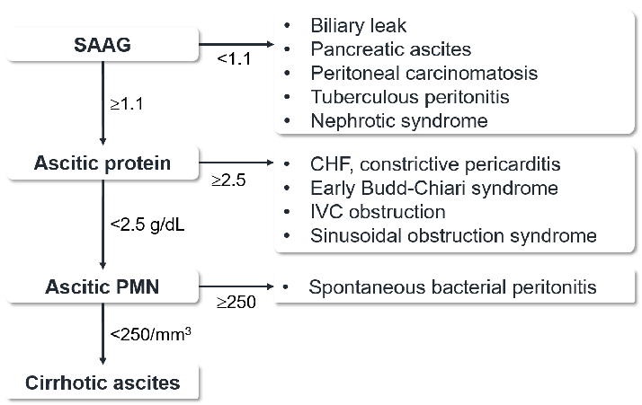
54-year-old man with alcohol-related cirrhosis
Albumin | 3.0
Fluid albumin | 1.0
Fluid total protein | 0.9
Fluid PMNs | 100
Fluid culture | Negative

Slide 60
54-year-old man with alcohol-related cirrhosis
Patient comes to your clinic 4 months later with severe abdominal distension and 10lbs weight gain
Large volume paracentesis done in the office, 5L removed
No SBP, consistent with cirrhotic ascites
What’s your next step?
Albumin | 3.0
Fluid albumin | 1.0
Fluid total protein | 0.9
Fluid PMNs | 100
Fluid culture | Negative

Slide 61
54-year-old man with alcohol-related cirrhosis
Patient comes to your clinic 4 months later with severe abdominal distension and 10lbs weight gain
Large volume paracentesis done in the office, 5L removed
No SBP, consistent with cirrhotic ascites
What’s your next step?
Start Spironolactone and Lasix 5:2 ratio
  Max dose is 400mg:160mg daily
Albumin | 3.0
Fluid albumin | 1.0
Fluid total protein | 0.9
Fluid PMNs | 100
Fluid culture | Negative

Slide 62
54-year-old man with alcohol-related cirrhosis
Patient comes to your clinic 4 months later with severe abdominal distension and 10lbs weight gain
Large volume paracentesis done in the office, 5L removed
No SBP, consistent with cirrhotic ascites
What’s your next step?
Start Spironolactone and Lasix 5:2 ratio
  Max dose is 400mg:160mg daily
Anything else?
Albumin | 3.0
Fluid albumin | 1.0
Fluid total protein | 0.9
Fluid PMNs | 100
Fluid culture | Negative

Slide 63
54-year-old man with alcohol-related cirrhosis
Patient comes to your clinic 4 months later with severe abdominal distension and 10lbs weight gain
Large volume paracentesis done in the office, 5L removed
No SBP, consistent with cirrhotic ascites
What’s your next step?
Start Spironolactone and Lasix 5:2 ratio
  Max dose is 400mg:160mg daily
Anything else?
  You could start SBP primary prophylaxis with Bactrim (or cipro)
    This remains a little controversial, and most hepatologists will not do it.
Albumin | 3.0
Fluid albumin | 1.0
Fluid total protein | 0.9
Fluid PMNs | 100
Fluid culture | Negative

Slide 64
54-year-old man with alcohol-related cirrhosis
Patient comes to your clinic 2 months later with shortness of breath

Slide 65
54-year-old man with alcohol-related cirrhosis
Patient comes to your clinic 2 months later with shortness of breath
  His symptoms improve when he lays down

Slide 66
54-year-old man with alcohol-related cirrhosis
Patient comes to your clinic 2 months later with shortness of breath
  His symptoms improve when he lays down
  What is this called?

Slide 67
54-year-old man with alcohol-related cirrhosis
Patient comes to your clinic 2 months later with shortness of breath
  His symptoms improve when he lays down
  What is this called? Platypnea

Slide 68
54-year-old man with alcohol-related cirrhosis
Patient comes to your clinic 2 months later with shortness of breath
  His symptoms improve when he lays down
  What is this called? Platypnea
  You measure his pulse ox and it worsens when he sits up
  What is this called?

Slide 69
54-year-old man with alcohol-related cirrhosis
Patient comes to your clinic 2 months later with shortness of breath
  His symptoms improve when he lays down
  What is this called? Platypnea
  You measure his pulse ox and it worsens when he sits up
  What is this called? Orthodeoxia

Slide 70
54-year-old man with alcohol-related cirrhosis
Patient comes to your clinic 2 months later with shortness of breath
  His symptoms improve when he lays down
  What is this called? Platypnea
  You measure his pulse ox and it worsens when he sits up
  What is this called? Orthodeoxia
What’s going on?

Slide 71
54-year-old man with alcohol-related cirrhosis
Patient comes to your clinic 2 months later with shortness of breath
  His symptoms improve when he lays down
  What is this called? Platypnea
  You measure his pulse ox and it worsens when he sits up
  What is this called? Orthodeoxia
What’s going on? – hepatopulmonary syndrome
What’s your next step?

Slide 72
54-year-old man with alcohol-related cirrhosis
Patient comes to your clinic 2 months later with shortness of breath
  His symptoms improve when he lays down
  What is this called? Platypnea
  You measure his pulse ox and it worsens when he sits up
  What is this called? Orthodeoxia
What’s going on? – hepatopulmonary syndrome
What’s your next step?
TTE with bubble study

Slide 73
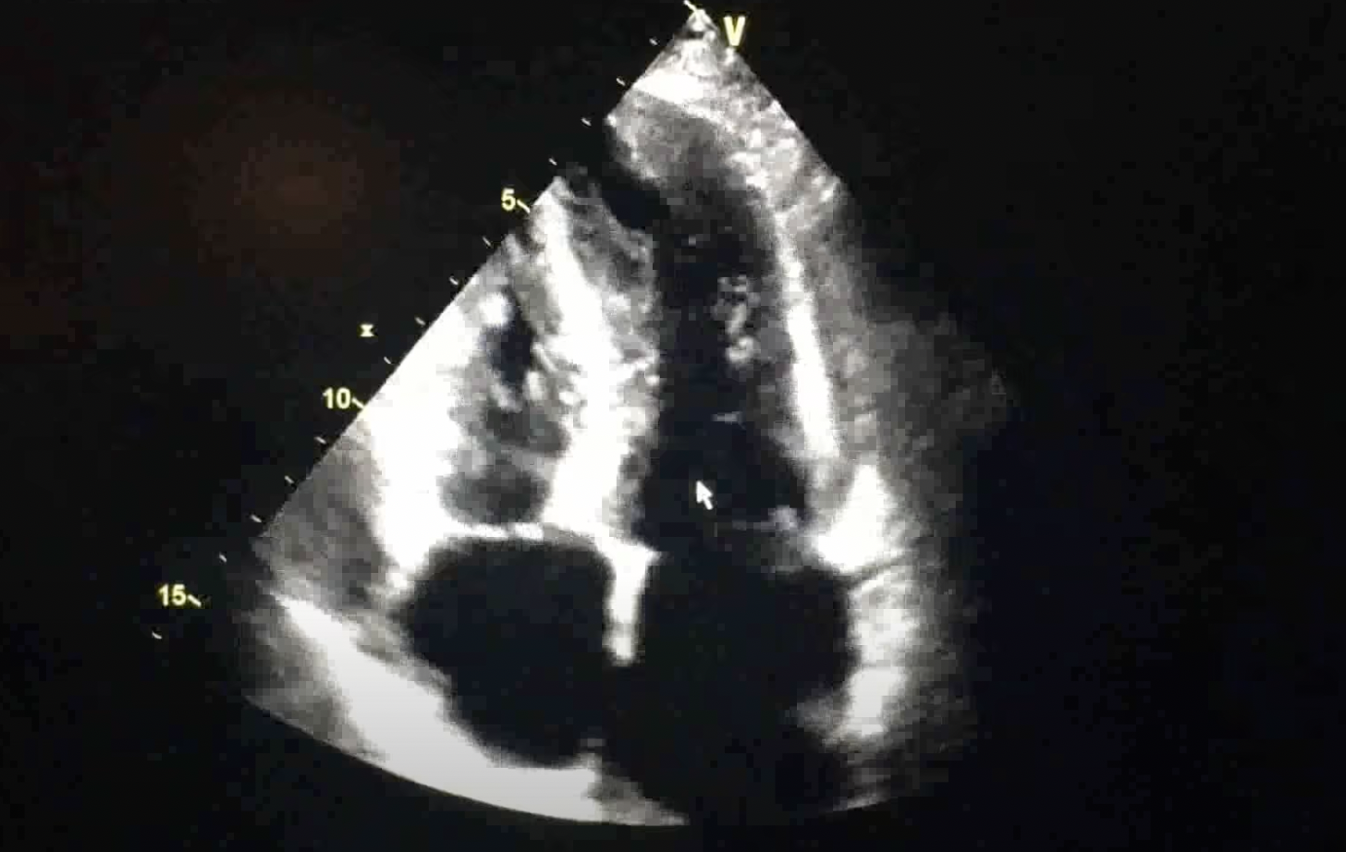
54-year-old man with alcohol-related cirrhosis

Slide 74
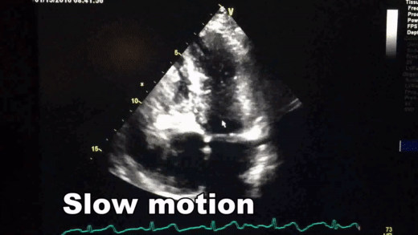
54-year-old man with alcohol-related cirrhosis

Slide 75
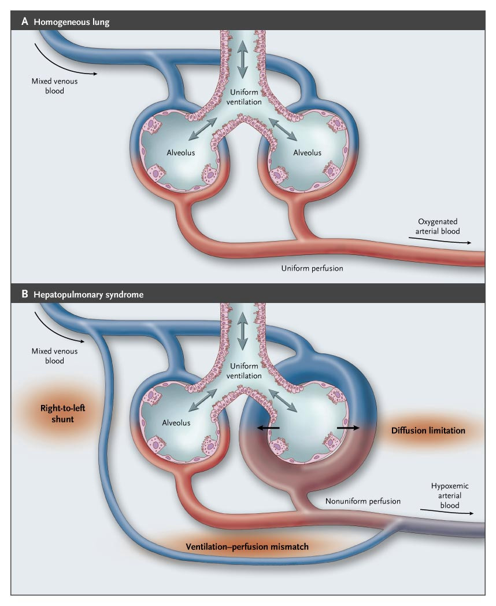

Slide 77
54-year-old man with alcohol-related cirrhosis
You diagnose him with hepatopulmonary syndrome
What’s your next step?

Slide 78
54-year-old man with alcohol-related cirrhosis
You diagnose him with hepatopulmonary syndrome
What’s your next step?
ABG (on RA), Home O2, and referral to transplant
  (remember initial work up was when he didn’t have any of those complications)
Patient agrees to see addiction medicine and decides to stop drinking
Transplant evaluation begins

Slide 79
54-year-old man with alcohol-related cirrhosis
Patient presents to your office 1 month later saying he had been losing track of his car keys often, and displacing objects around the house
How do you confirm your suspicion?

Slide 80
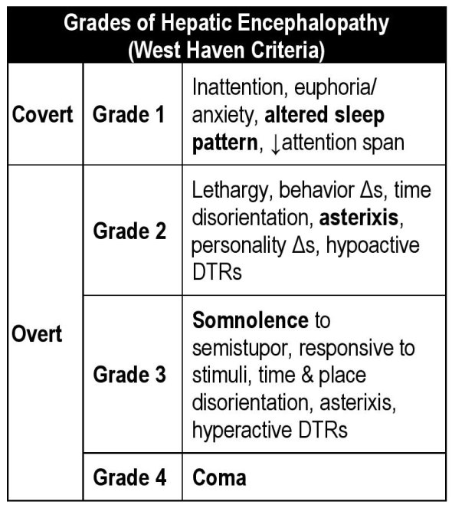
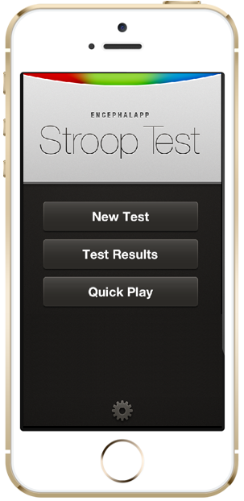

54-year-old man with alcohol-related cirrhosis
Patient presents to your office 1 month later saying he had been losing track of his car keys often, and displacing objects around the house
How do you confirm your suspicion?
You can use the Stroop test App!

Slide 81
54-year-old man with alcohol-related cirrhosis
Patient presents to your office 1 month later saying he had been losing track of his car keys often, and displacing objects around the house
You diagnose with HE grade 1
What will you do next?

Slide 82
54-year-old man with alcohol-related cirrhosis
Patient presents to your office 1 month later saying he had been losing track of his car keys often, and displacing objects around the house
You diagnose with HE grade 1
What will you do next?
Start lactulose

Slide 83
54-year-old man with alcohol-related cirrhosis
Let’s recap
He is a 54M w/ alcohol-related cirrhosis c/b ascites, variceal bleed, hepatic encephalopathy, and hepatopulmonary syndrome.
Meds:
  Spironolactone
  Lasix
  Bactrim
  Carvedilol
  Lactulose
  Home O2

Slide 84
54-year-old man with alcohol-related cirrhosis
Patient presents to the hospital 2 months later with severe abdominal pain
What’s the next step?

Slide 85
54-year-old man with alcohol-related cirrhosis
Patient presents to the hospital 2 months later with severe abdominal pain
What’s the next step?
Paracentesis!
Fluid PMNs | 400
Fluid culture | PENDING

Slide 86
54-year-old man with alcohol-related cirrhosis
Patient presents to the hospital 2 months later with severe abdominal pain
What’s the next step?
Paracentesis!
How do you treat?
Fluid PMNs | 400
Fluid culture | PENDING

Slide 87
54-year-old man with alcohol-related cirrhosis
Patient presents to the hospital 2 months later with severe abdominal pain
What’s the next step?
Paracentesis!
How do you treat?
  Ceftriaxone 2 gm daily
  Albumin 1.5g/kg day 1, 1g/kg day 3
Any medication he takes you are concerned about?
Fluid PMNs | 400
Fluid culture | PENDING

Slide 88
54-year-old man with alcohol-related cirrhosis
Patient presents to the hospital 2 months later with severe abdominal pain
What’s the next step?
Paracentesis!
How do you treat?
  Ceftriaxone 2 gm daily
  Albumin 1.5g/kg day 1, 1g/kg day 3
Any medication he takes you are concerned about?
STOP THE BETA BLOCKER!
Fluid PMNs | 400
Fluid culture | PENDING

Slide 89
54-year-old man with alcohol-related cirrhosis
He still has mild abdominal pain on day 3 as he is getting the albumin
What do you do next?

Slide 90
54-year-old man with alcohol-related cirrhosis
He still has mild abdominal pain on day 3 as he is getting the albumin
What do you do next? RETAP!
What do you expect/hope for?

Slide 91
54-year-old man with alcohol-related cirrhosis
He still has mild abdominal pain on day 3 as he is getting the albumin
What do you do next? RETAP!
What do you expect/hope for? Improvement of >20% of PMNs
 | Day 1 | Day 3
Fluid PMNs | 400 | 380
Fluid culture | NEGATIVE | N/A

Slide 92
54-year-old man with alcohol-related cirrhosis
He still has mild abdominal pain on day 3 as he is getting the albumin
What do you do next? RETAP!
What do you expect/hope for? Improvement of >20% of PMNs
What do we call this?
 | Day 1 | Day 3
Fluid PMNs | 400 | 380
Fluid culture | NEGATIVE | N/A

Slide 93
^{PMNs} ^{Culture} | <250 | >= 250
Negative
Positive

Slide 94
^{PMNs} ^{Culture} | <250 | >= 250
Negative | Normal | CNNA
Positive | NNBA | SBP

Slide 95
54-year-old man with alcohol-related cirrhosis
Abdominal symptoms continue to improve on day 4

Slide 96
54-year-old man with alcohol-related cirrhosis
Abdominal symptoms continue to improve on day 4
Noted to have developed AKI
What do you do next?
Admission Creat | 1.0
Day 4 Creat | 1.8

Slide 97
54-year-old man with alcohol-related cirrhosis
Abdominal symptoms continue to improve on day 4
Noted to have developed AKI
What do you do next?
Check criteria for HRS
Admission Creat | 1.0
Day 4 Creat | 1.8

Slide 98
54-year-old man with alcohol-related cirrhosis
Abdominal symptoms continue to improve on day 4
Noted to have developed AKI
What do you do next?
Check criteria for HRS
  ✅ Cirrhosis and ascites
Admission Creat | 1.0
Day 4 Creat | 1.8

Slide 99
54-year-old man with alcohol-related cirrhosis
Abdominal symptoms continue to improve on day 4
Noted to have developed AKI
What do you do next?
Check criteria for HRS
  ✅ Cirrhosis and ascites
  ✅ No shock
Admission Creat | 1.0
Day 4 Creat | 1.8

Slide 100
54-year-old man with alcohol-related cirrhosis
Abdominal symptoms continue to improve on day 4
Noted to have developed AKI
What do you do next?
Check criteria for HRS
  ✅ Cirrhosis and ascites
  ✅ No shock
  ✅ No recent nephrotoxic drugs
Admission Creat | 1.0
Day 4 Creat | 1.8

Slide 101
54-year-old man with alcohol-related cirrhosis
Abdominal symptoms continue to improve on day 4
Noted to have developed AKI
What do you do next?
Check criteria for HRS
  ✅ Cirrhosis and ascites
  ✅ No shock
  ✅ No recent nephrotoxic drugs
  ✅ No signs of structural kidney injury (<500 mg/day proteinuria, <50 RBCs/HPF, normal renal US, inactive sediment)
Admission Creat | 1.0
Day 4 Creat | 1.8

Slide 102
54-year-old man with alcohol-related cirrhosis
Abdominal symptoms continue to improve on day 4
Noted to have developed AKI
What do you do next?
Check criteria for HRS
  ✅ Cirrhosis and ascites
  ✅ No shock
  ✅ No recent nephrotoxic drugs
  ✅ No signs of structural kidney injury (<500 mg/day proteinuria, <50 RBCs/HPF, normal renal US, inactive sediment)
  ✅ No improvement after stopping diuretics and volume expansion with albumin (1g/kg albumin x2d, max 100g/d)
Admission Creat | 1.0
Day 4 Creat | 1.8

Slide 103
54-year-old man with alcohol-related cirrhosis
You diagnose the patient with hepatorenal syndrome

Slide 104
54-year-old man with alcohol-related cirrhosis
You diagnose the patient with hepatorenal syndrome
What do you do now?

Slide 105
54-year-old man with alcohol-related cirrhosis
You diagnose the patient with hepatorenal syndrome
What do you do now?
  Midodrine and Octreotide do not really work
  Terlipressin is the treatment of choice if CLIF-ACLF < 3
  Norepinephrine if CLIF-ACLF >= 3
  Vasopressin adjunct therapy
Goal is to increase MAP by > 10 from baseline
Use RRT only if transplant candidate
Urgent transplant evaluation!

Slide 106
54-year-old man with alcohol-related cirrhosis
Patient improves and creatinine goes back to baseline
Discharged from the hospital to follow up with you in 2 weeks

Slide 107
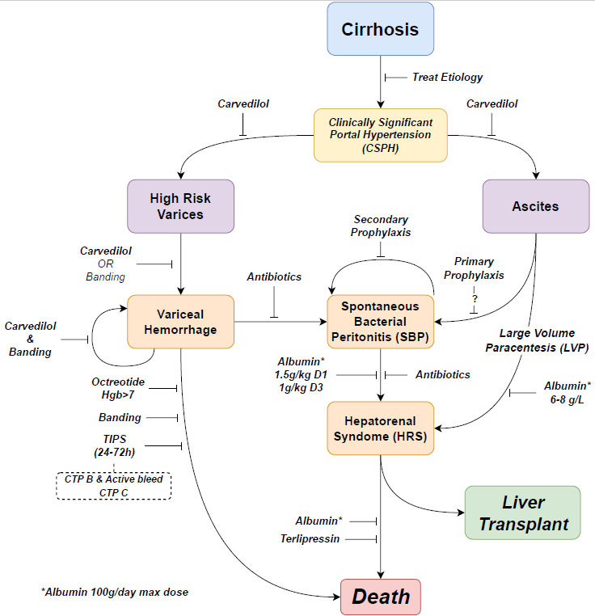

Slide 108
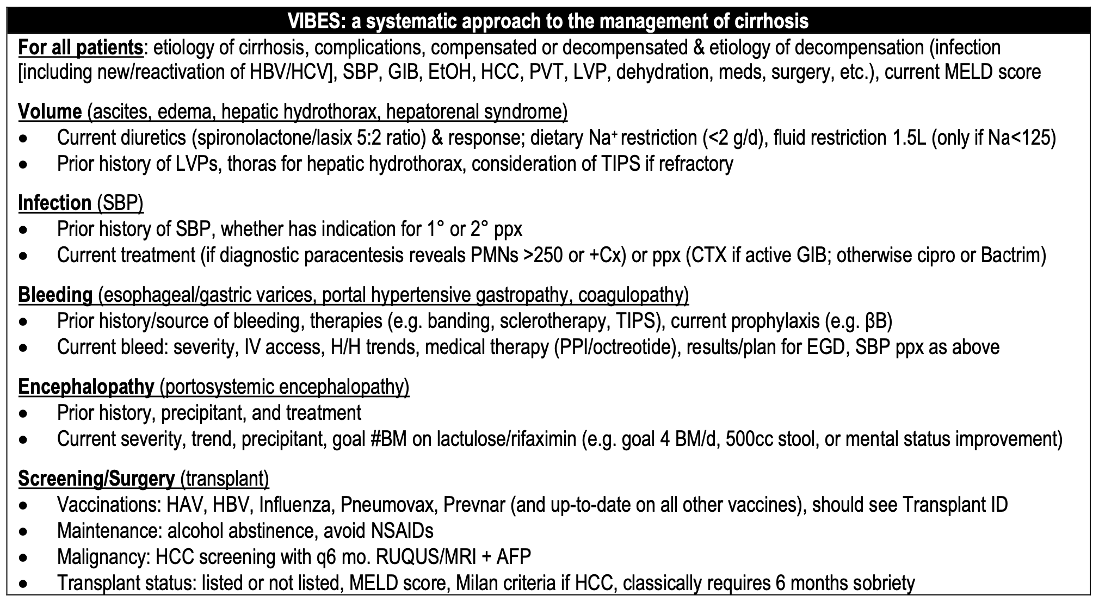
54-year-old man with alcohol-related cirrhosis

Slide 109
Some tricks of the trade
AST:ALT ratio (even wnl) mean something
  AST>ALT is almost always abnormal
Thrombocytopenia? You’re cirrhotic until proven otherwise
HRS is difficult to diagnose and dx of exclusion, don’t forget the UA, renal US and 1g/kg albumin for 2 days
BB are great, but know when to stop them (i.e., SBP, HRS)
Always think of transplant candidacy for any cirrhotic
  DO NOT DISMISS THEM JUST BECAUSE THEY DRINK ALCOHOL as things are more dynamic

